Slide 1
Real-Time Human Pose Recognition in Parts from Single Depth Images
Presented by: Mohammad A. Gowayyed

Slide 2
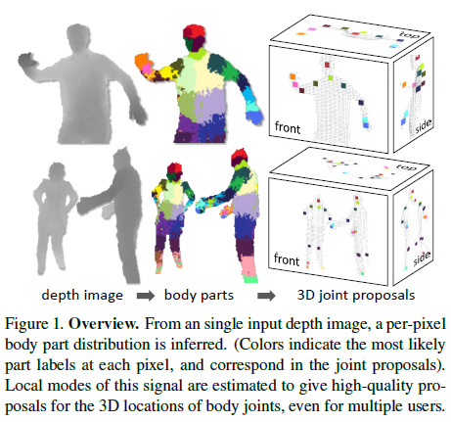

Slide 3
Pose Estimation
Input: image or video containing people
Output: joints locations (pose)

Slide 4
Applications
Gaming
Human-computer interaction
Security
Telepresence
Health-care

Slide 5
Related Work
No previous “interactive” pose estimation from depth cameras.

Slide 6
Approach
Focus: detecting from a single depth image a small set of 3D position candidates for each skeletal joint
Treat the segmentation into body parts as a per-pixel classification task
Training data: generate realistic synthetic depth images of humans of many shapes and sizes in highly varied poses sampled from a large motion capture database

Slide 7
Approach
Train a deep randomized decision forest classifier which avoids overfitting by using hundreds of thousands of training images (can use GPUs to speed up the classification)
Spatial modes of the inferred per-pixel distributions are computed using mean shift resulting in the 3D joint proposals.
200 Frame/Second on Xbox 360 GPU

Slide 8
Synthetic data
Use Motion capture data (mocap)
The database consists of approximately 500k frames in a few hundred sequences of driving, dancing, kicking, running, navigating menus, etc.
Use a subset of 100k poses such that no two poses are closer than 5cm.
uses standard computer graphics techniques to render depth

Slide 9
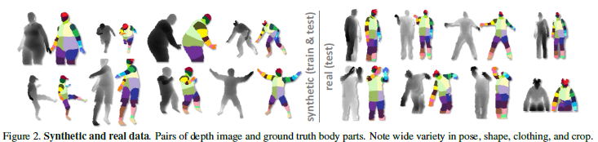
Synthetic data

Slide 10
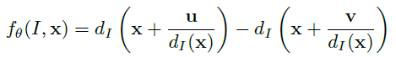
Depth Image Features
Simple depth comparison features

Slide 11
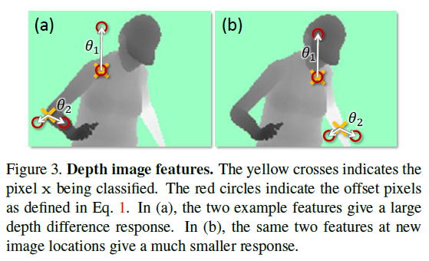
Depth Image Features

Slide 12
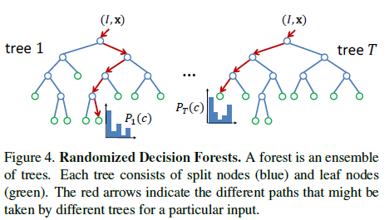
Randomized Decision Forests

Slide 13
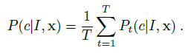
Randomized Decision Forests
A forest is an ensemble of T decision trees, each consisting of split and leaf nodes. Each split node consists of a feature f_{Ɵ} and a threshold T.
To classify pixel x in image I, one starts at the root and repeatedly evaluates Eq. 1, branching left or right according to the comparison to threshold.
At the leaf node reached in tree t, a learned distribution P_{t}(c|I, x) over body part labels c is stored.
The distributions are averaged together for all trees in the forest to give the final classification

Slide 14
Training the forest
Each tree is trained on a different set of randomly synthesized images. A random subset of 2000 example pixels from each image is chosen to ensure a roughly even distribution across body parts.

Slide 15
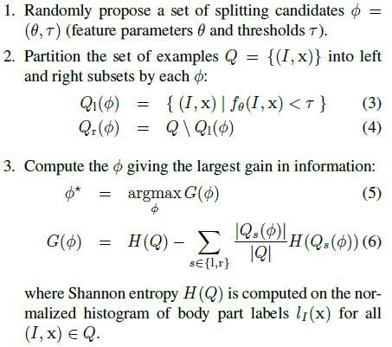
Training the forest

Slide 16
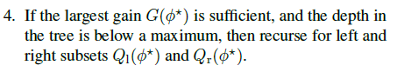
Training the forest
To keep the training times down they employ a distributed implementation.
Training 3 trees to depth 20 from 1 million images takes about a day on a 1000 core cluster.

Slide 17
Joint positions proposals
Body part recognition as described above infers per-pixel information.
This information must now be pooled across pixels to generate reliable proposals for the positions of 3D skeletal joints.
A simple option is to accumulate the global 3D centers of probability mass for each part, using the known calibrated depth. However, outlying pixels severely degrade the quality of such a global estimate.

Slide 18
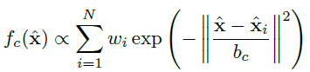
Joint positions proposals
Instead they employ a local mode-finding approach based on mean shift with a weighted Gaussian kernel.
They define a density estimator per body part as:

Slide 19
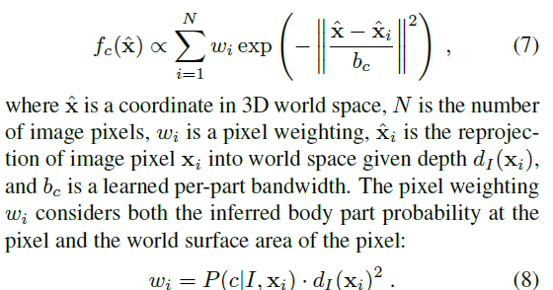
Joint positions proposals

Slide 20
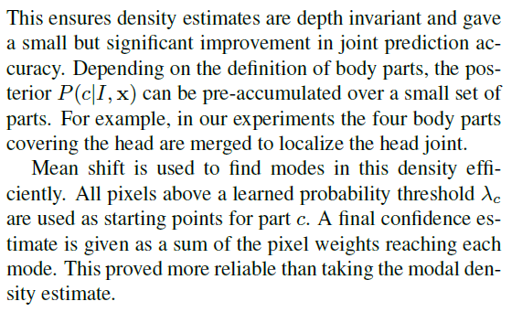
Joint positions proposals

Slide 21
Experiments and Discussion
Still

