Slide 1
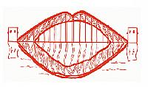
Automated Lip reading technique for people with speech disabilities by converting identified visemes into direct speech using image processing and machine learning techniques
Presented by :
Ahmed Mesbah
Ahmed El-taybany
Mentor : Dr. Marwan Torki

Slide 2
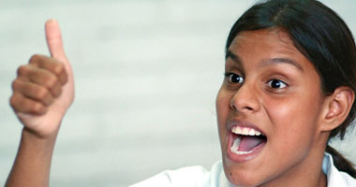
Problem
Deaf-muted
Remnants of hearing
Other speech disabilities

Slide 3
Statistics

Slide 4
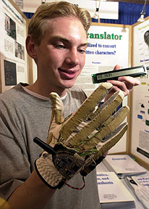
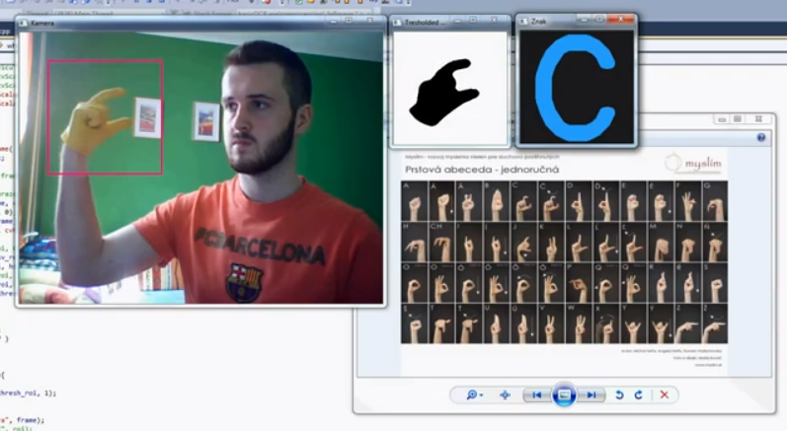
Background research
Sign language recognition

Slide 5
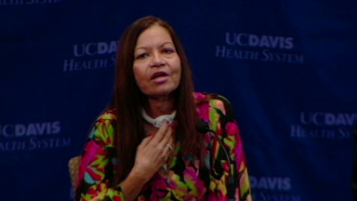
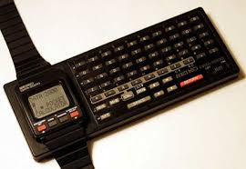
Watch keyboard Electronic larynx

Slide 6
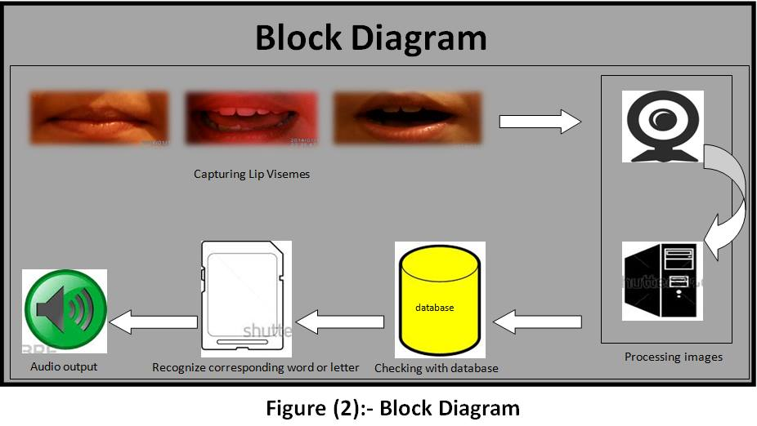
Main idea
- Decreasing physiological impacts
- Semi-normal state
- It was proved that human could replace ears with eyes for speech reading.

Slide 7
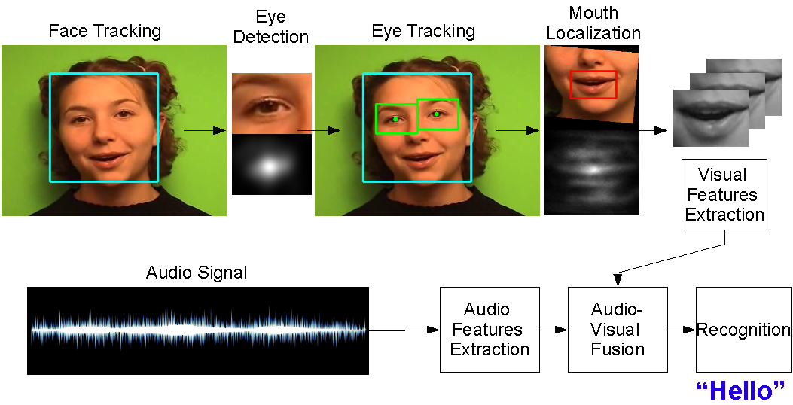
Audio-visual speech recognition (AVSR)

Slide 8
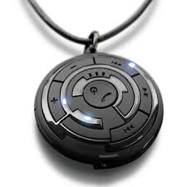
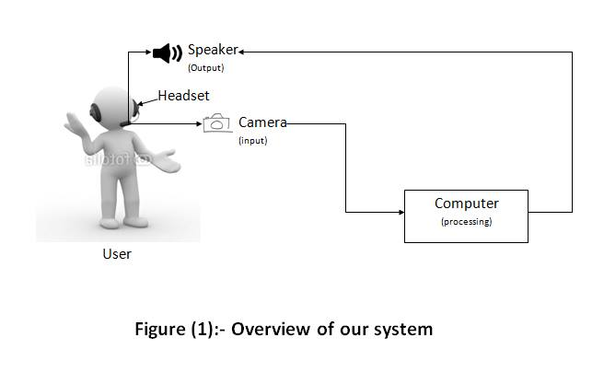
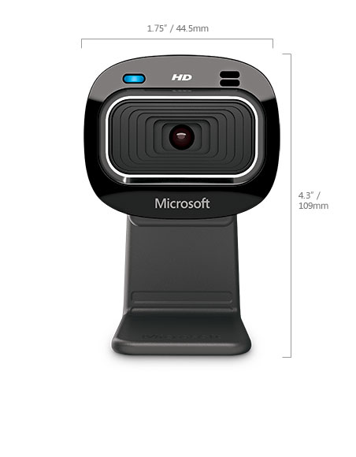
Capturing Hardware and design

Slide 9
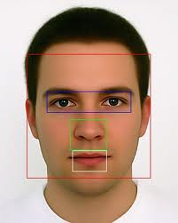
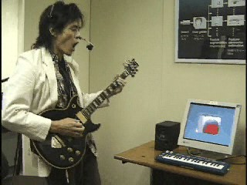
Design advantages and proof of concept
No more face detection
The Mouthesizer: A Facial Gesture Musical Interface 2004

Slide 10
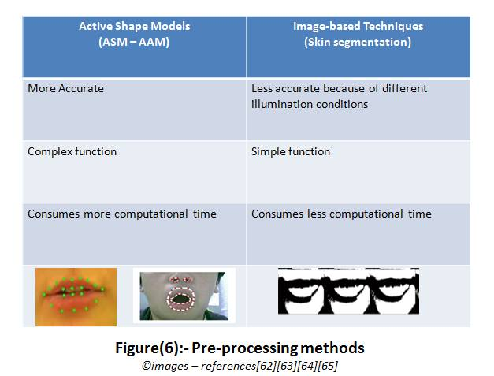
Lip Feature extraction
Image-based approaches
Model-based approaches

Slide 11

Lip Feature extraction used methods

Slide 12
Classifiers
- Hidden Markov Model and Neural Network were the most common classifiers

Slide 13
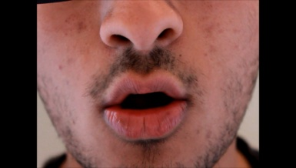
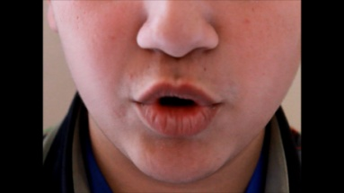
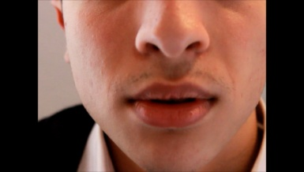
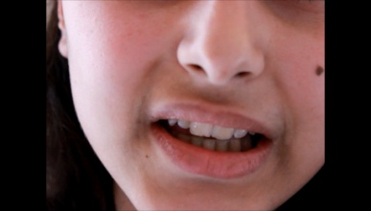
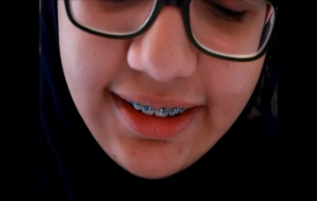
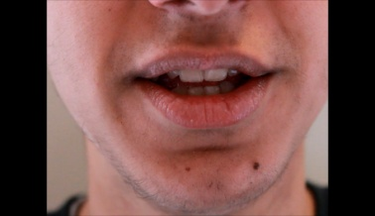
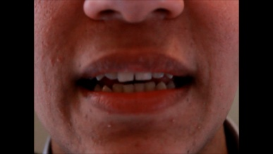
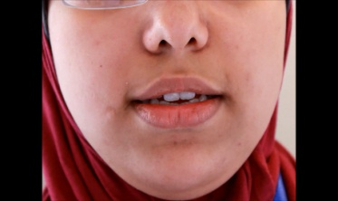
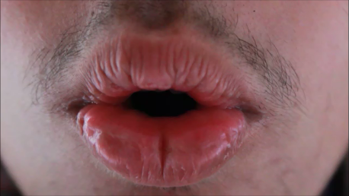
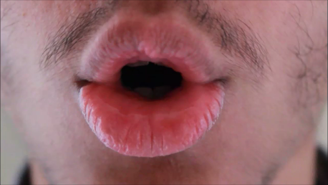
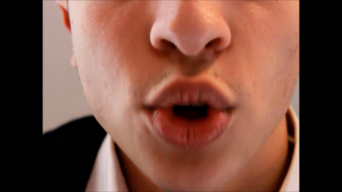
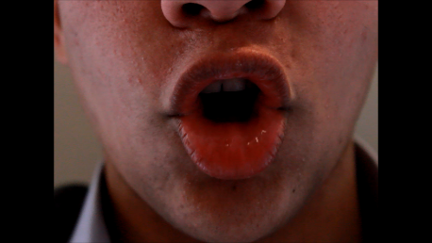
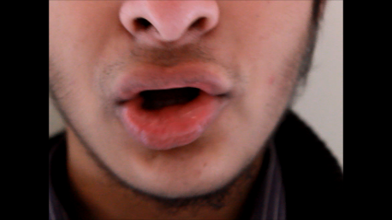
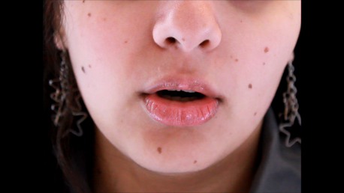
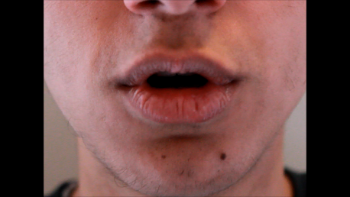
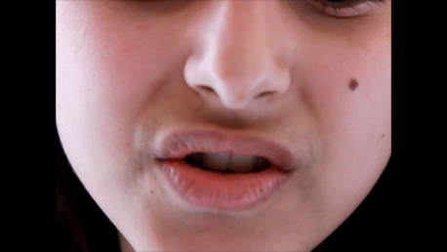
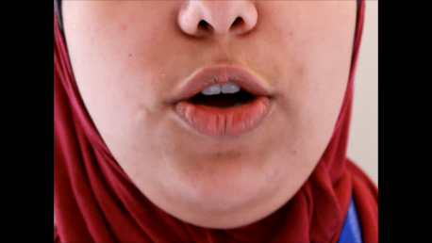
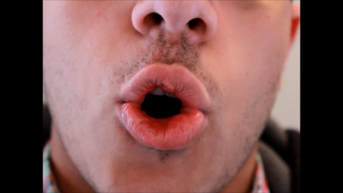
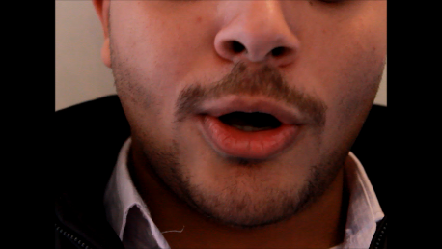
Dataset
- AV letters (University of East Angela)
- Oulu database (University of Oulu)
-CUAVE database (Clemson University)
- Home-made data set

Slide 14
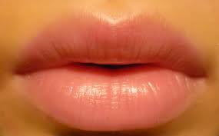
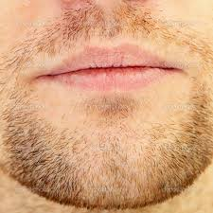
Lip reading system problems for multi-speaker
Variation in :
Accents
Talking speeds
Skin color
Lip shapes
Illumination conditions
Confusing recognition tasks
Facial hair

Slide 15
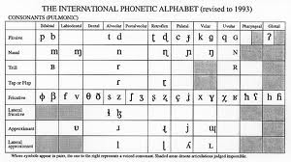
International phonetics alphabetic (IPA)
Visible speech
phonemes
visemes

Slide 16
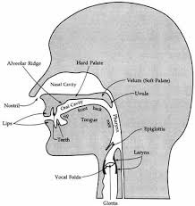
seen
unseen
phonemes
Letter Prediction methods
Using prediction technique to recover unseen letters like Microsoft Speech API or Google

Slide 17
Lip reading system
1
Input
2
Feature extraction
3
Classification
4
Output

Slide 18
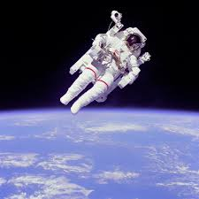
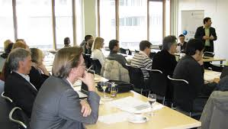
Applications

Slide 19
References
[1] Hsu, Rein-Lien, Abdel-Mottaleb, Mohamed, Jain, Anil K., Face Detection in Color mages, IEEE ICIP 1999, pp 622-626
[2] Lai-Kan-Thon, Olivier, Lips Localization, Brno 2003
[3] Smith, S. M., Brady, J. M., SUSAN – a new approach to low level image processing, International Journal of Computer Vision, 23(1):45-78, May 1997
[4] Ahlberg, J.: A system for face localization and facial feature extraction, Linkoping University, Tech.Rep. LiTH-ISY-R-2172
[5] Albiol, A., Torres, L., Delp, E. J.: Optimum color spaces for skin detection, In Proceeding of the International Conference on Image Processing 2001, vol. 1, 122-124
[6] G. Potamianos, C. Neti, G. Gravier, A. Garg, and A. W.Senior, “Recent advances in the automatic recognition of audio-visual speech,” Proc. IEEE, 91(9): 1306–1326, 2003.
[7] D. Gatica-Perez, G. Lathoud, J.-M. Odobez, and I. Mc-Cowan, “Multimodal multispeaker probabilistic trackingin meetings,” in Proc. Int. Conf. Multimodal Interfaces (ICMI), 2005.
[8] A. Pentland, “Smart rooms, smart clothes,” in Proc. Int.Conf. Pattern Recog. (ICPR), 1998.
[9] CHIL: Computers in the Human Interaction Loop. [Online]. Available: http://chil.server.de
[10] P. Lucey and G. Potamianos, “Lipreading using profile versus frontal views,” in Proc. Int. Works. Multimedia Signal
Process. (MMSP), pp. 24–28, 2006.
[11] P. Lucey, G. Potamianos, and S. Sridharan, “A unified approach to multi-pose audio-visual ASR,” (To Appear) in
Proc. Interspeech, 2007.

Slide 20

Thanks

