Slide 1
Group Sparsity and Geometry Constrained Dictionary Learning for Action
Recognition from Depth Maps
Jiajia Luo, Wei Wang, and Hairong Qi
The University of Tennessee, Knoxville
Presented by: Marwan Torki

Slide 2
Abstract
Approach: Sparse Coding and TPM (Temporal pyramid matching).
A discriminative class-specific dictionary learning algorithm is proposed for sparse coding.
  adding the group sparsity and geometry constraints, and the geometry relationships among features are also kept in the calculated coefficients.
Benchmark evaluation on MSRAction3D and DailyActivities.

Slide 3
Introduction
Intra-class variability due to RGB sensors
Cost Effective sensors for D-RGB solves many problems of RGB sensors only.
Action is reflected on the Joints/ skeleton. Give visual example, Shotton et.al work
Problems of noise also occurs in Depth.
3d joint representations are there as well as depth map representations. Cite some literature

Slide 4
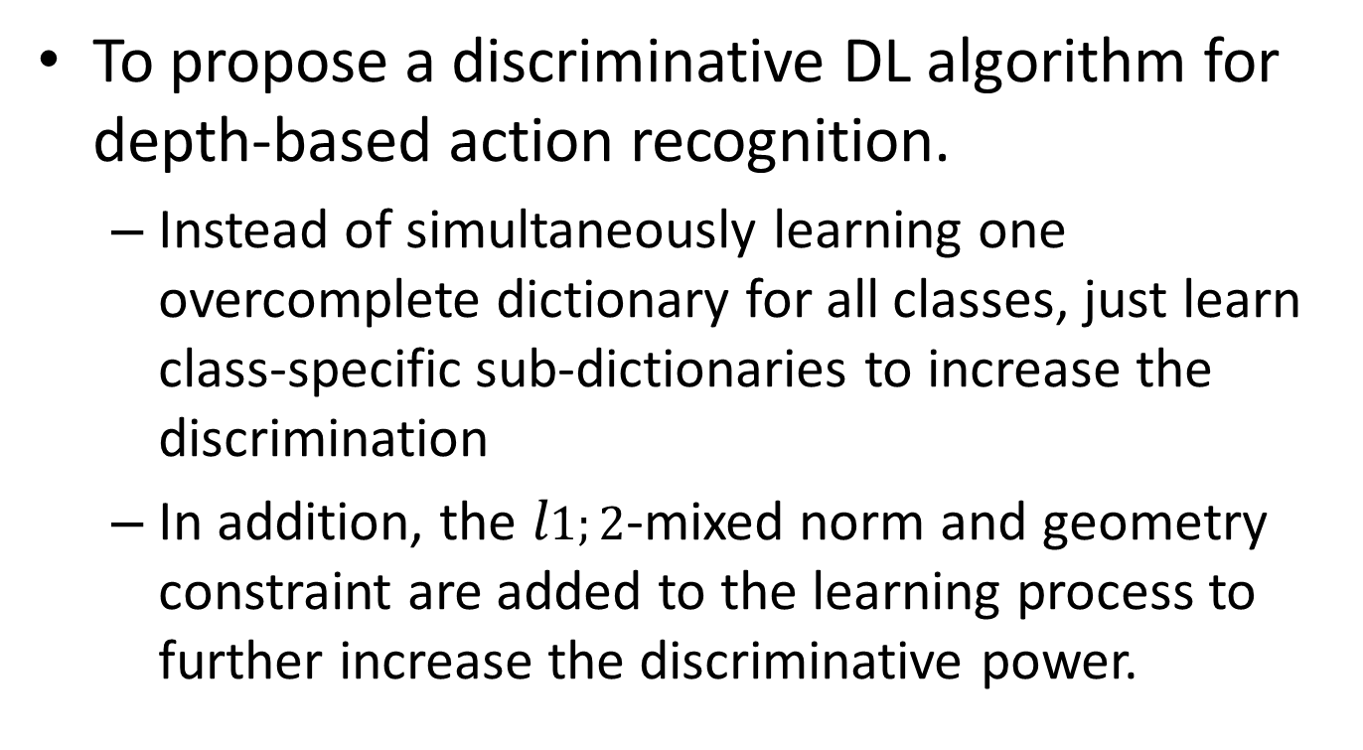
Paper Contribution
To propose a discriminative DL algorithm for depth-based action recognition.
  Instead of simultaneously learning one overcomplete dictionary for all classes, just learn class-specific sub-dictionaries to increase the discrimination
  In addition, the $l1;2$-mixed norm and geometry constraint are added to the learning process to further increase the discriminative power.

Slide 5
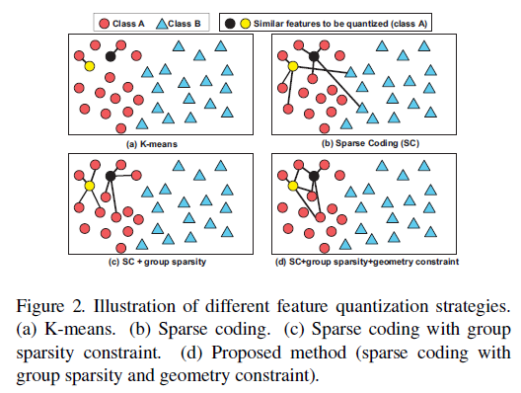
Role of Group Sparsity and Geometric constraints

Slide 6


Sparse Coding BG
Optimize
Class Specific, then optimize

Slide 7
Proposed Methods
Feature Extraction
  Joint locations features: center point at one reference point → 57 features only per frame.
  Group Sparsity and Geometry Constrained Dictionary Learning (DLGSGC).
    Kmeans dictionaries have large quantization errors

Slide 8
Group Sparsity and Geometry Constrained Dictionary Learning (DLGSGC)
Group sparsity constraint to the class-specific dictionary learning has three advantages.
  First, the intraclass variations among features can be compressed since features from the same class tend to select atoms within the same group (sub-dictionary).
  Second, influence of correlated atoms from different sub-dictionaries can be compromised since their coefficients will tend to be zero or nonzero simultaneously.
  Third, possible randomness in coefficients distribution can be removed since coefficients have group clustered sparse characteristics.
Add geometry constraint to the class-specific dictionary learning process.

Slide 9
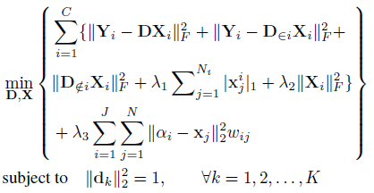
Objective function
1- Fix D and get X
2- Fix X and get D
3- Iterate

Slide 10
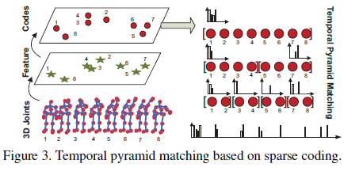
Representation and Classification
Compute coefficients
Use TPM representation on The coefs.
Linear SVM on the histograms (maxpooling is applied

Slide 11
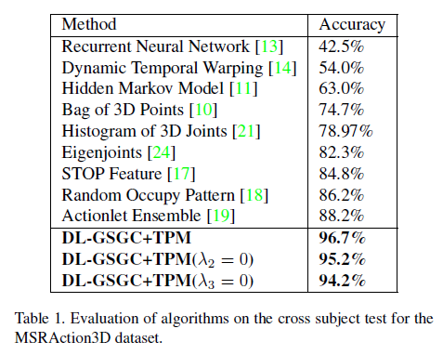
Results

Slide 12
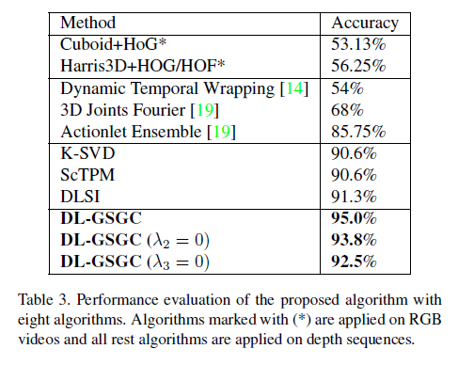
Results

Slide 13
Discussion
I didn’t get the representation and the quantization argument. Seems that for every frame!!
Results are awesome.
Worth to master the topic.

