Slide 1
Tomasulo Algorithm Example

Slide 2
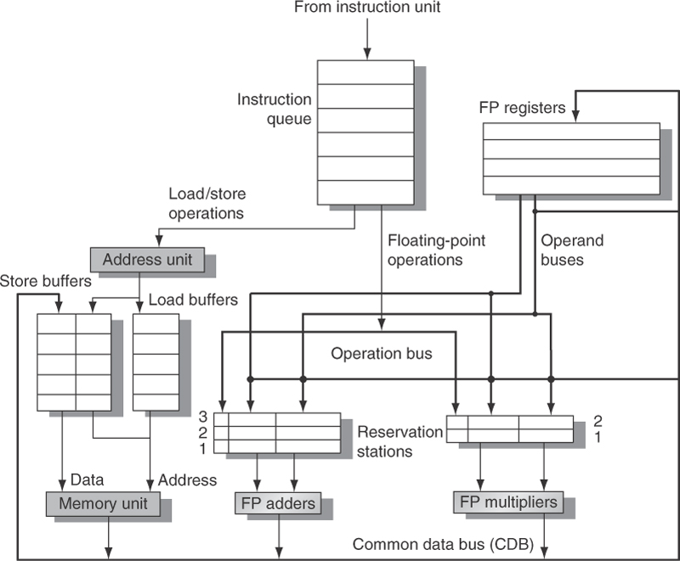
Cycle 1:
LD1 – Issue/GenAddr
ADD F6, F8, F2
DIV F10, F0, F6
SUB F8, F6, F2
MLT F0, F2, F4
LD F2, 45(R3)
LD F6, 34(R2)

Slide 3
Cycle 2:
LD1 – LD Buffer
LD2 – Issue/GenAddr
ADD F6, F8, F2
DIV F10, F0, F6
SUB F8, F6, F2
MLT F0, F2, F4
LD F2, 45(R3)
LD F6, 34(R2)

Slide 4
Cycle 3:
LD1 – Loading
LD2 – LD Buffer
MUL – Issue/Wait on F2
ADD F6, F8, F2
DIV F10, F0, F6
SUB F8, F6, F2
MLT F0, F2, F4
LD F2, 45(R3)
LD F6, 34(R2)

Slide 5
Cycle 4:
LD1 – Broadcast CDB
LD2 – Loading
MUL – Wait on F2
SUB – Issue/Wait on F2
ADD F6, F8, F2
DIV F10, F0, F6
SUB F8, F6, F2
LD F2, 45(R3)
MLT F0, F2, F4
LD F6, 34(R2)

Slide 6
Cycle 5:
LD2 – Broadcast CDB
MUL – F2 Ready/ Exec
SUB – F2 Ready/ Exec
DIV – Issue/ Wait on F0
ADD F6, F8, F2
DIV F10, F0, F6
MLT F0, F2, F4
SUB F8, F6, F2
LD F2, 45(R3)

Slide 7
Cycle 6:
MUL –Exec
SUB –Exec
DIV – Wait on F0
Add – Issue/ Wait on F8
ADD F6, F8, F2
DIV F10, F0, F6
SUB F8, F6, F2
MLT F0, F2, F4

Slide 8
Cycle 7:
MUL –Exec
SUB – Exec Done
DIV – Wait on F0
Add – Wait on F8
DIV F10, F0, F6
ADD F6, F8, F2
SUB F8, F6, F2
MLT F0, F2, F4

Slide 9
Cycle 8:
MUL –Exec
SUB – Broadcast CDB
DIV – Wait on F0
Add – F8 Ready/ Exec
DIV F10, F0, F6
ADD F6, F8, F2
SUB F8, F6, F2
MLT F0, F2, F4

Slide 10
Cycle 9:
MUL –Exec
DIV – Wait on F0
Add – Exec
DIV F10, F0, F6
ADD F6, F8, F2
MLT F0, F2, F4

Slide 11
Cycle 10:
MUL –Exec
DIV – Wait on F0
Add – Exec Done
DIV F10, F0, F6
ADD F6, F8, F2
MLT F0, F2, F4

Slide 12
Cycle 11:
MUL –Exec
DIV – Wait on F0
Add – Broadcast CDB
Note: We don’t overwrite F6, because F6 value from LD1 was buffered in the RS at Issue (Cycle 5)
DIV F10, F0, F6
ADD F6, F8, F2
MLT F0, F2, F4

Slide 13
Cycle 12-14:
MUL –Exec
DIV – Wait on F0
Cycle 15:
MUL –Exec Done
DIV – Wait on F0
DIV F10, F0, F6
MLT F0, F2, F4

Slide 14
Cycle 16:
MUL – Broadcast CDB
DIV – F0 Ready/ Exec
DIV F10, F0, F6
MLT F0, F2, F4

Slide 15
Cycle 17-55:
DIV – Exec
Cycle 56:
DIV – Exec Done
DIV F10, F0, F6

Slide 16
Cycle 57:
DIV – Broadcast CDB
DIV F10, F0, F6

